Slide 1

Detección de máscara
Guided By: Presented by:
Prof. Himani Trivedi Patel Deep R.(19BEIT30010)
Prajapati Dhvanil N.(19BEIT30016)
Kothari Jainam G.(19BEIT30027)
Bunha Kunj C.(19BEIT30038)

Slide 2
Table Of Content
Introduction
Objectives
Scope
Data Acquisition
Flow of System
Face Detection
Training
Face Recognition
Screenshots

Slide 3
Introduction
Since the world is hit by COVID-19, wearing the face masks is essential.
The detection of people wearing the face masks in public places is the real need of hour.
‘Detección de máscara’ is the Spanish translation of “Detection of mask”, is a system that detects if the person is wearing the face masks properly or not.
It uses supervised learning approach.
It can also recognize the person who is not wearing the face masks and make log of it in the system.

Slide 4
Objectives
To create a User Interface (UI) with database interaction, where the attendees can register themselves.
To train our model to detect face masks properly, a valid labelled and cleaned dataset is required.
To train the model using CNN architecture, then test the model to determine the accuracy of model and improve the accuracy.
To recognize the persons who are not wearing face masks properly and alert the organizer.

Slide 5
SCOPE
This system can be used to generate the E-Challans by integrating with public CCTV surveillances.
This system can be used in educational institutes for monitoring the student and staff members without face masks.
The system can be used in public places to allow entry to people only if they are wearing face masks.
It can be used to contribute into generating valuable statistical data that helps organizations to take appropriate actions.

Slide 6
Data Acquisition
The accuracy of the model depends on the dataset which is used to train the model.
The dataset used in the training of system is Real-World Masked Face (RMFD).
The dataset is gathered from GitHub.
These dataset contains images of two classes, they are :
Images of people with face mask
Images of people without face mask
We have 1970 images of people with mask and 1935 images of people without masks.
Dataset URL : https://github.com/X-zhangyang/Real-World-Masked-Face-Dataset

Slide 7
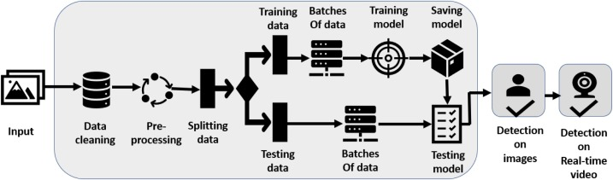
Flow of system
For the implementation of this system, there are two stages involved which are :
To detect all the faces from the images or live videos to feed in the model.
To detect if the faces are covered with face masks or not.
Fig : Flow of System

Slide 8
Face Detection
To detect face masks the first stage is to detect faces in the video or images.
There are various methods to detect the faces in the videos like using Haar Cascade, Histogram Oriented Gradient (HOG), YOLO, etc.
We used Single Shot Detector (SSD) for the face detection which is an one stage object detector.
It uses standard Convolutional Neural Network (CNN) architecture.

Slide 9




Training
Before training the model, we split our dataset into 80% training dataset and 20% testing dataset.
To train the model we make use of the following libraries :
OpenCV
Matplotlib
Numpy
TensorFlow
Keras
Fig : Python and ML Libraries

Slide 10
MobileNetV2
MobileNetV2 is a neural network architecture released by Google.
It is a very efficient feature extractor for object detection and segmentation.
There are two types of blocks in MobileNetV2, they are:
Residual block with stride of 1.
Downsizing block with stride of 2.
There are 3 layers for both types of blocks.
It uses various non-linear functions such as ReLU, Sigmoid function, etc as an activation functions.

Slide 11
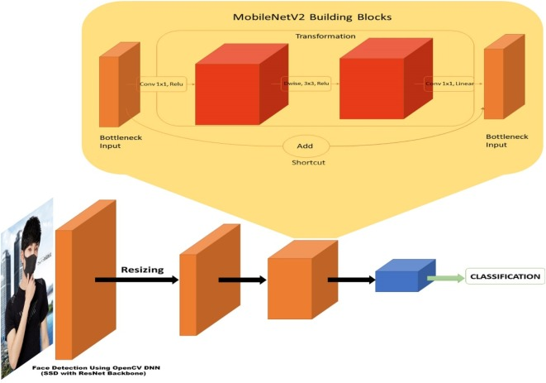
Fig : Architecture of MobileNetV2

Slide 12
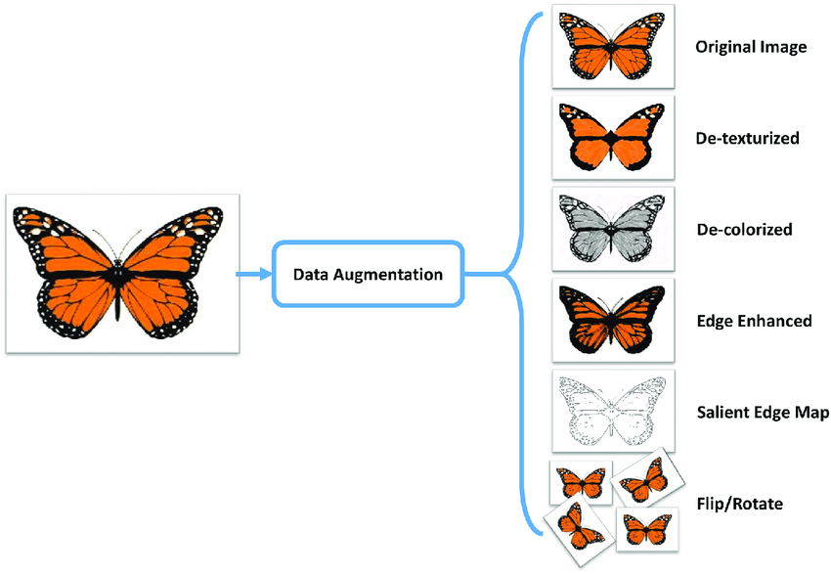
Data Augmentation
Data augmentation is a strategy that enables practitioners to significantly increase the diversity of data available for training models, without actually collecting new data.
We use data augmentation technique such as rotation_range, zoom_range are used to train large neural networks.
We used ImageDataGenerator() function to augment images in real time while training.
Fig : Data Augmentation Example

Slide 13
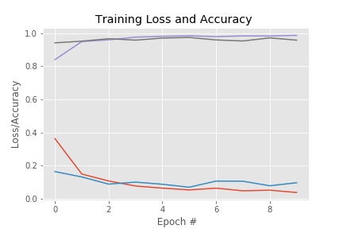
TEsTING Results
The testing results of our model for the 10 Epochs, learning rate 0.0001 and batch size 32.
We use ReLU as activation function in hidden layer and softmax as activation for output layer.
In the graph,
Red line denotes training loss
Blue line denotes testing loss
Purple line denotes training accuracy
Brown line denotes testing accuracy
Fig : Training Loss and Accuracy graph

Slide 14
Face Recognition
Once the faces are detected, the next stage is to recognize the person who is not wearing the face mask and make an entry of the same in the Log file.
This log file can be further used by the administrator to send the emails to the notify the users with the time, date and their image without wearing face mask.
Face recognition can be done with the help of Histogram Oriented Gradients (HOG) approach which is an object detection technique.
HOG calculates the gradient by combining the magnitude and angle from the image.

Slide 15
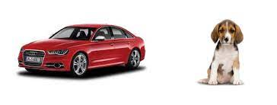
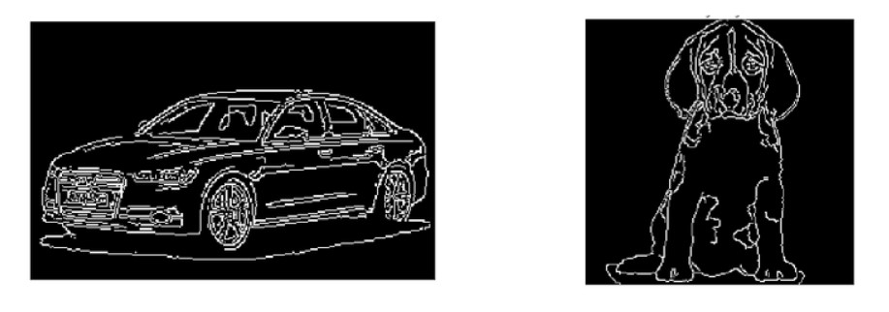
Fig : Histogram Oriented Gradient

Slide 16
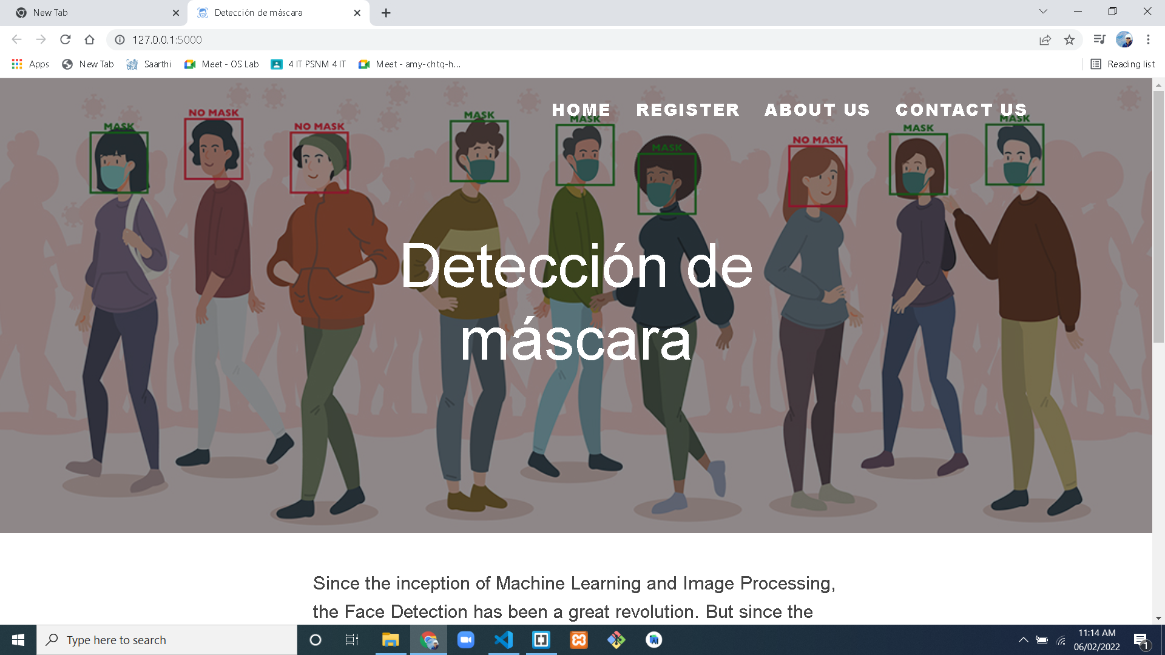
Screenshots

Slide 17


Slide 18


Slide 19


Slide 20
Thank YOU

